Slide 1
Sample Labs
A virtual ecosystem to accelerate Machine Learning and Data Science development, by churning machine digestible versions of extremely large datasets.
Elexie Munyeneh • Dec 11, 2020

Slide 2
Sample Labs
Existing Problem:
ML workflows consume huge amounts of memory, and require large disk spaces. Tools unavailable to many data scientists.
Online platforms such as AWS and Azure may solve the problem, however there are faults
Complexity
Requires Credit/Debit card. Fear of incurring charges inhibits experimentation
Not useful for Rapid prototyping
Not designed solely for Data Science

Slide 3
Sample Labs
What motivates me to develop Sample Labs:
I was first introduced to Data Science at a hackathon hosted by my University in 2017. The theme was Economic Mobility. We were tasked to examine various socioeconomic datasets to derive intelligent solutions for tackling the problem.
However, none of the participants were able to make significant progress, since the datasets were too large for personal machines. I encountered the same problem at another data science that same year themed at addressing the Opioid Crisis.
And once again this year, the problem persists. At my current internship at a Fortune 200 company, I experienced another size problem. It prompted my company to distribute Amazon credits to select members of the IT department. Due to the complexity of AWS, it took at least a month to receive the credits.

Slide 4
Sample Labs
What motivates me to develop Sample Labs:
Thousands of Research papers, freely available on the web, address various problems in Society, Data Science, and Machine Learning. However, the papers are often unreplicable by the layman (and even professionals) due to shortage of GPU and CPUS

Slide 5
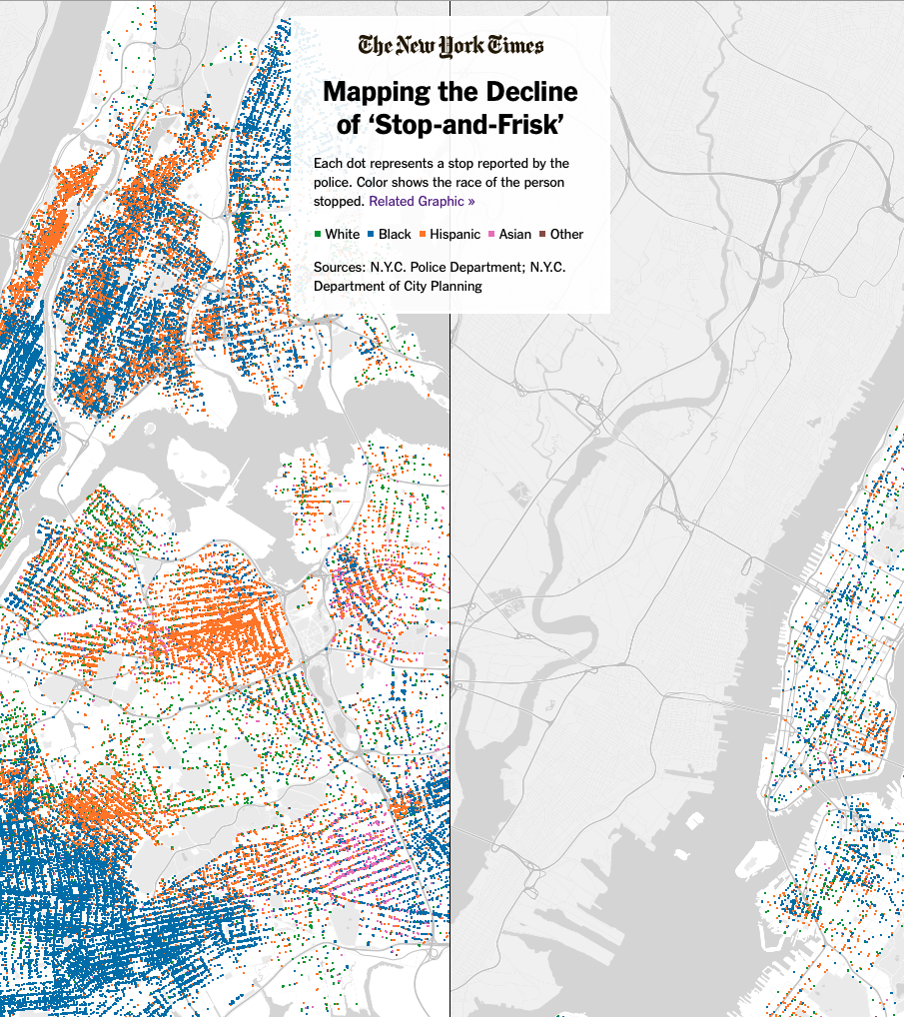

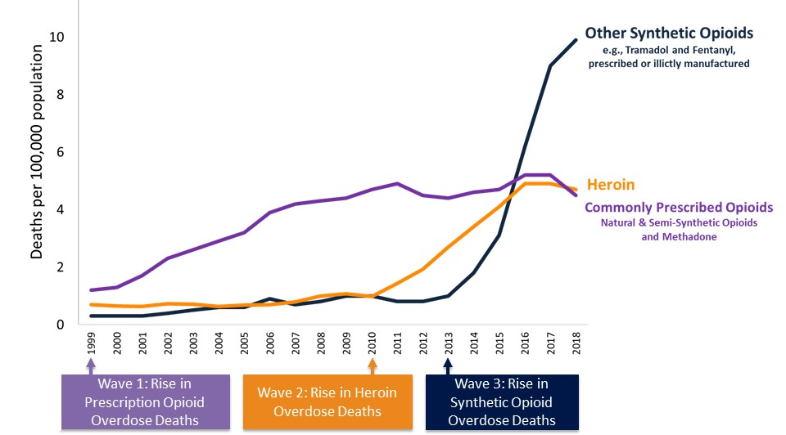
Sample Labs
Raj Chetty, Harvard Economist and Chief author of Race and Economic Opportunity in the United States: An Intergenerational Perspective∗

Slide 6
Sample Labs
Examples of problems I have studied in Society, Data Science, and Machine Learning:
Society : GeoSpatial Business Intelligence, Economic Mobility, Intergenerational Economic Mobility, Access to Healthcare Facilities, Traffic Prediction,etc
Data Science and Machine Learning : Layer Transfer, PCA on Layers of a Natural Language Processing Model, Model Tuning and Freezing, Parallelization and Distributed Training, etc

Slide 7
Sample Labs
Implementation:
User uploads large dataset via direct link or through GUI. Sample Labs returns a stratified sample of the data based on the User’s Configuration
Sample Dataset can be worked on locally.
User may also upload executable files (first configured to work on the sample dataset) that can be superimposed onto the larger dataset for further insights
Community of verified professionals(Open ID) and amateurs that may annotate your code (for optimization), incorporating features of Github and StackOverflow, while primarily targeting Large Dataset and Data Science Problems

Slide 8
Sample Labs
Example of how Sample Lab may solve the memory problem by offering different computational configurations:
User uploads a dataset and is presented with a list of termintable GPU and CPU instances abstracted over AWS tools, paying by hour or by size complexity of configuration; monthly charges only accrue for storage.
Image on the following slide taken from https://tech.marksblogg.com/benchmarks.html , and showcase various query times on the same dataset--NYC 1.1 billion trips data

Slide 9
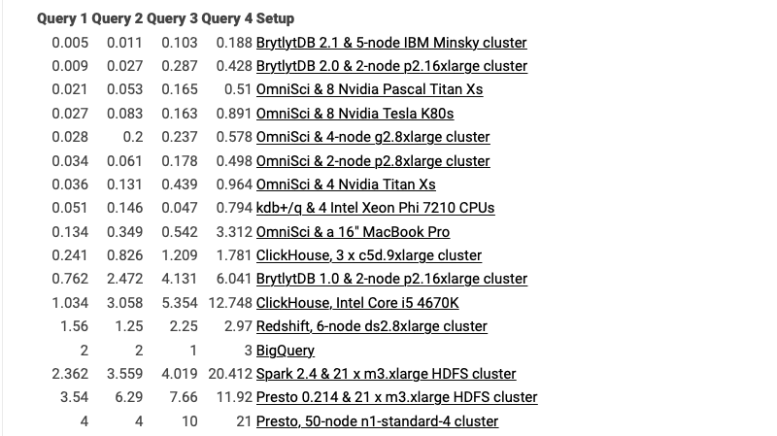

Slide 10
White Papers and Research Papers Consulted:
Renters and Owners — Visualizing every person in the US. | https://medium.com/hackernoon/renters-and-owners-visualizing-every-person-in-the-us-ba97d3c49c02
How to Visualize Urban Transformation | https://medium.com/@staehlli/how-to-visualize-urban-transformation-f8801b62a6ad
3D mapping global population density: How I built it | https://blog.mapbox.com/3d-mapping-global-population-density-how-i-built-it-141785c91107
US Census Bureau | https://api.census.gov/data.html

Slide 11
White Papers and Research Papers Consulted:
Geographic Mobility in America: Evidence from Cell Phone Data
The Impacts of Neighborhoods on Intergenera- tional Mobility II: County-level Estimates
Artificial Intelligence and Machine Learning: Current Applications in Real Estate (117 pg.s)
Improving geographical accessibility modeling for operational use by local health actors
Architecture for Modular Microsimulation of Real Estate Markets and Transportation

Slide 12
White Papers and Research Papers Consulted:
Rapid Adaptation of BERT for Information Extraction on Domain-Specific Business Documents
Exploring the Urban - Rural Incarceration Divide: Drivers of Local Jail Incarceration Rates in the U.S.
Artificial Intelligence and Machine Learning: Current Applications in Real Estate (117 pg.s)
Improving geographical accessibility modeling for operational use by local health actors
Architecture for Modular Microsimulation of Real Estate Markets and Transportation

Slide 13
White Papers and Research Papers Consulted:
How To: Reuse Database Connections in AWS Lambda
Data Consistency in Microservices Architecture
Running Apache Spark on AWS | https://medium.com/acast-tech/running-apache-spark-on-aws-81a5f766d3a6

Slide 14
Sample Labs
Thank You!

